Slide 1
Implementing Source Coding Using the Huffman Encoder Algorithm on Audio Signals
Shabi Melwin C,ECE
Suriyabharathi SK,ECE

Slide 2
Outline
Introduction
Market Survey
Implementation steps
Results and Discussions
Conclusions
References
Acknowledgements

Slide 3
Introduction
This project implements Source coding technique which is used to efficiently compress data needed to transmit information.
In audio signal processing, source coding helps reduce the file size of audio signals without significantly compromising sound quality.
Huffman encoder algorithm reduces audio signal’s redundancy which makes it perfect for uses like audio streaming and transmission.

Slide 4
Problem Statement
Design and implement an efficient audio compression system using Huffman coding to reduce the storage requirements and transmission bandwidth of audio files, while maintaining acceptable audio quality.

Slide 5
Market Survey
Target Sectors:
Broadcast and Streamin Platforms,Telecommunications,Speech and Audio Processing Devices.
Current Challenges:
High Storage Costs: Audio archives and datasets consume significant storage resources, increasing operational costs.
Bandwidth Limitations: High-quality audio requires substantial bandwidth for streaming or transmission, especially over limited networks.

Slide 6
Market Survey
Current Compression Techniques:
MP3 and AAC: Common lossy audio compression standards that reduce file size but may lose some quality, making them less ideal for all sectors.
FLAC and ALAC: Widely used lossless compression formats that provide high-quality audio preservation but are sometimes less efficient in compression ratios.

Slide 7
Market Survey
Huffman Encoding as a Solution:
Efficient Compression for Certain Applications: Huffman encoding offers a flexible approach to compressing audio files without sacrificing quality, ideal for applications where preserving audio fidelity is critical.
Cost-Effective: By reducing file sizes without quality loss, Huffman encoding can lower storage and bandwidth costs, especially in long-term audio data archiving and streaming.

Slide 8
Implementation Steps
Data Collection: WAV type audio signals are chosen as they store raw, uncompressed data, making them ideal for lossless compression analysis.
Frequency Analysis: It sets the stage for compression by identifying which values appear most often.
Huffman Encoding: It creates a binary tree based on the frequency of each value, assigning shorter codes to frequent values.
Encoding the Signal: Replacing each value in the audio signal with its Huffman code reduces the overall data size, as the encoded version has fewer bits than the original.

Slide 9
Flow Diagram
Input Audio Signal
Digital Conversion
Frequency Analysis
Generate Huffman codes
Compress Audio data
Storage and Transmit data

Slide 10
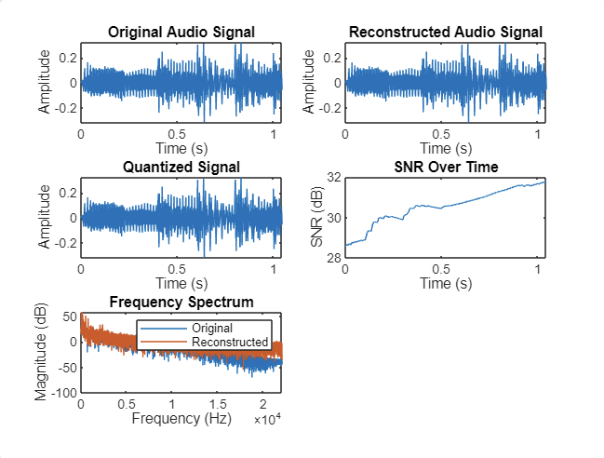
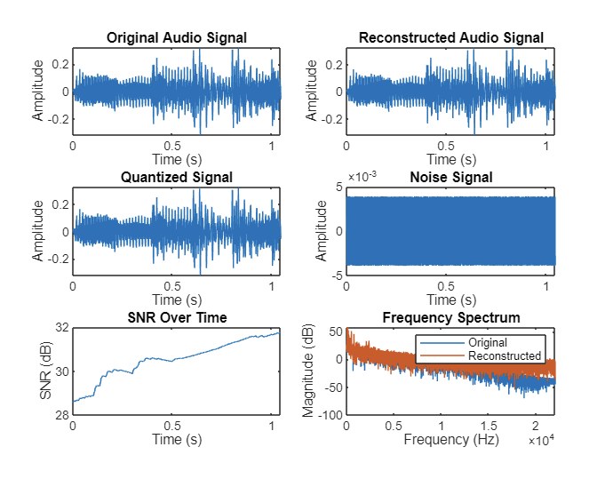
Results and Discussions

Slide 11
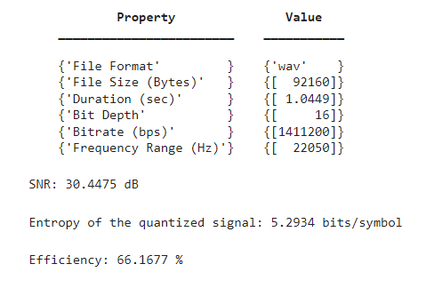
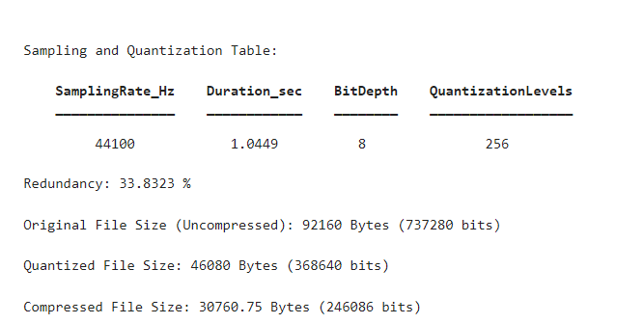
Results and Discussions

Slide 12
Conclusions
Implementing the Huffman Encoder Algorithm for audio signals provides an effective solution for compressing digital audio data without sacrificing quality.
The results demonstrate that Huffman encoding is a valuable tool in optimizing storage and bandwidth for various applications in the digital audio industry.

Slide 13
References
https://samplelib.com/sample-wav.html
https://mp3cut.net/
https://Nagahara-masaaki.github.io/assets/pdfs/PS_File/sice2004.pdf
http://www.nerdkits.com/videos/halloween_huffman_audio/
https://ieeexplore.ieee.org/document/1491556

Slide 14
Acknowledgement
I acknowledge my gratitude and thank to all my teacher, friends and my family members for their constant encouragement.

Slide 15
THANK YOU

